Slide 1






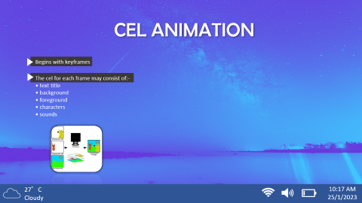
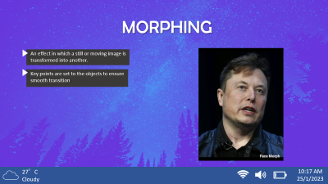
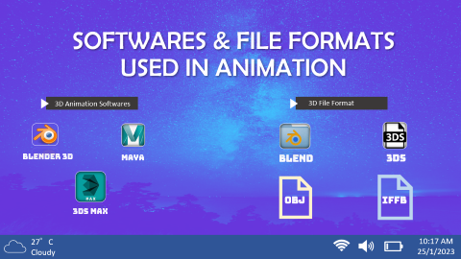
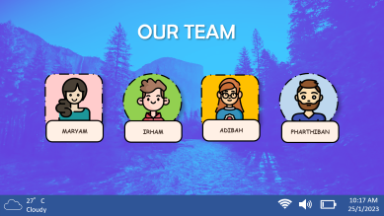
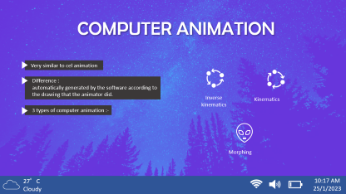
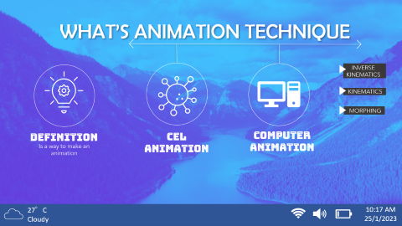

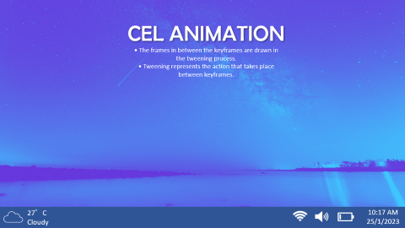
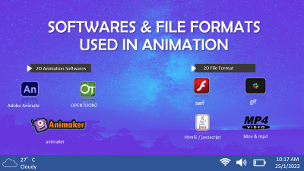
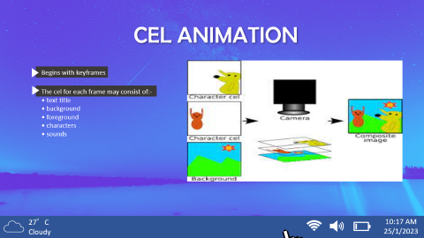

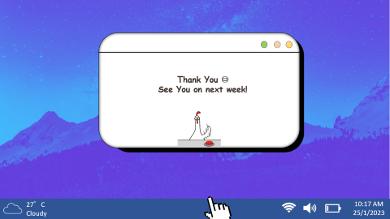
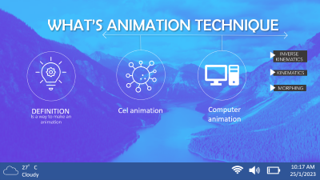

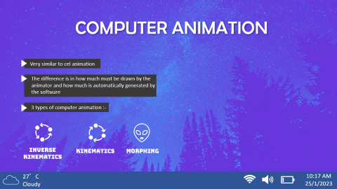
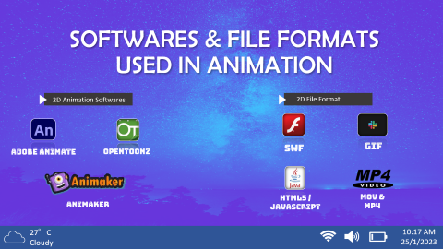
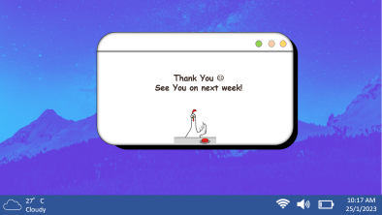
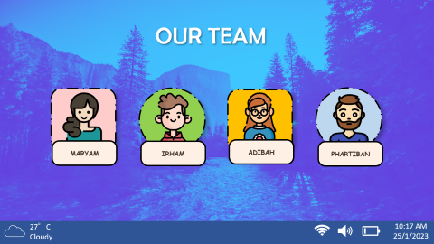
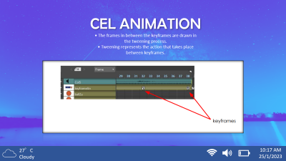
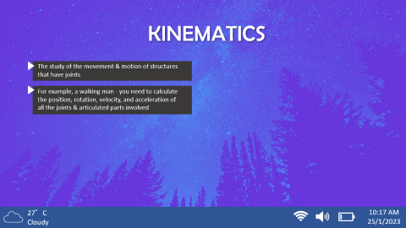


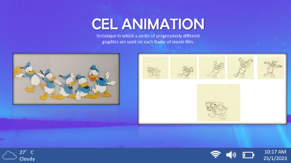


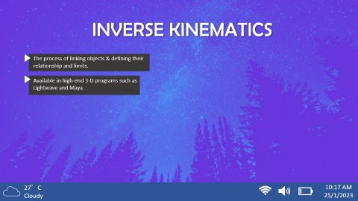
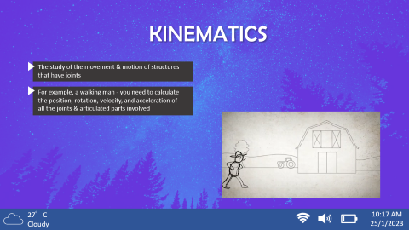
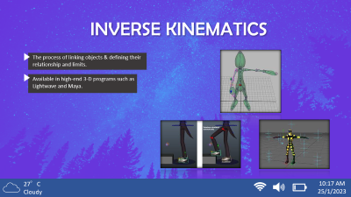
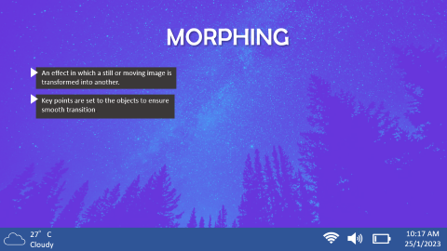

ANIMATION TECHNIQUES
ANIMATION TECHNIQUES
27°C
Cloudy
10:17 AM
25/1/2023

Slide 2
ANIMATION TECHNIQUES
ANIMATION TECHNIQUES
27°C
Cloudy
10:17 AM
25/1/2023

Slide 3
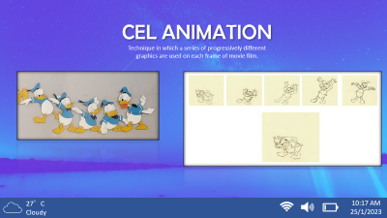
ANIMATION TECHNIQUES
ANIMATION TECHNIQUES
27°C
Cloudy
10:17 AM
25/1/2023

Slide 4
ANIMATION TECHNIQUES
ANIMATION TECHNIQUES
27°C
Cloudy
10:17 AM
25/1/2023

Slide 5
ANIMATION TECHNIQUES
ANIMATION TECHNIQUES
27°C
Cloudy
10:17 AM
25/1/2023

Slide 6
ANIMATION TECHNIQUES
ANIMATION TECHNIQUES
27°C
Cloudy
10:17 AM
25/1/2023

Slide 7



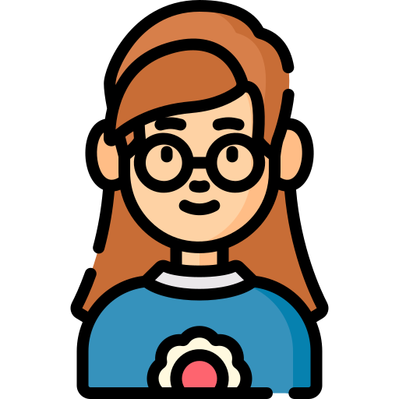

OUR TEAM
MARYAM
IRHAM
ADIBAH
PHARTHIBAN
27°C
Cloudy
10:17 AM
25/1/2023

Slide 8






WHAT’S ANIMATION TECHNIQUE
INVERSE KINEMATICS
KINEMATICS
MORPHING
DEFINITION
Cel animation
Computer animation
Is a way to make an animation
27°C
Cloudy
10:17 AM
25/1/2023

Slide 9

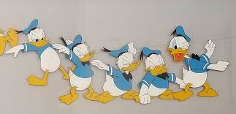
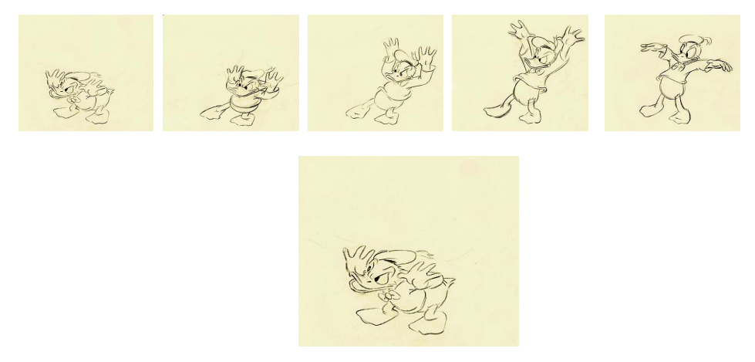
CEL ANIMATION
Technique in which a series of progressively different graphics are used on each frame of movie film.
27°C
Cloudy
10:17 AM
25/1/2023

Slide 10
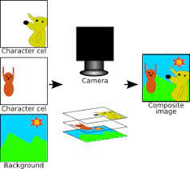

CEL ANIMATION
Begins with keyframes
The cel for each frame may consist of:-
• text title
• background
• foreground
• characters
• sounds
27°C
Cloudy
10:17 AM
25/1/2023

Slide 11
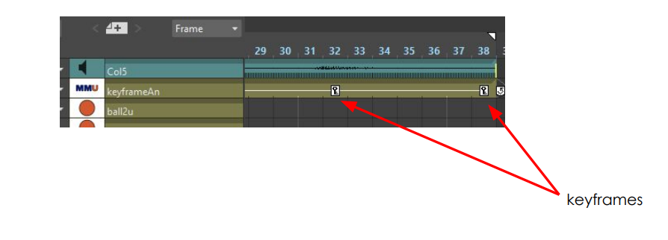
CEL ANIMATION
• The frames in between the keyframes are drawn in the tweening process.
• Tweening represents the action that takes place between keyframes.
27°C
Cloudy
10:17 AM
25/1/2023

Slide 12


COMPUTER ANIMATION
Very similar to cel animation
Difference :
automatically generated by the software according to the drawing that the animator did.
Inverse kinematics
Kinematics
3 types of computer animation :-
Morphing
27°C
Cloudy
10:17 AM
25/1/2023

Slide 13
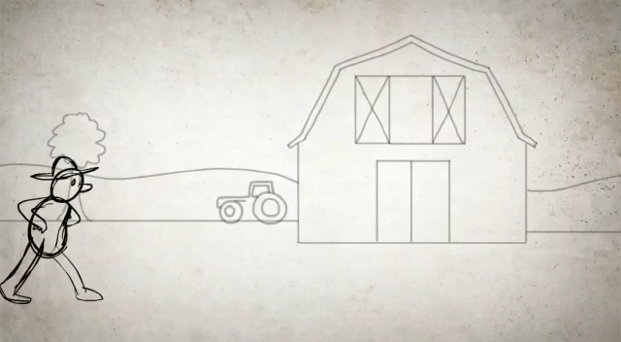
KINEMATICS
The study of the movement & motion of structures that have joints
For example, a walking man - you need to calculate the position, rotation, velocity, and acceleration of all the joints & articulated parts involved
27°C
Cloudy
10:17 AM
25/1/2023

Slide 14
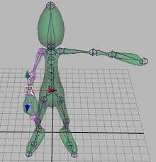
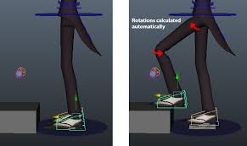
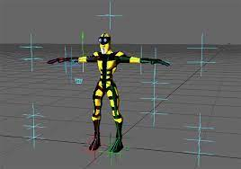
INVERSE KINEMATICS
The process of linking objects & defining their relationship and limits.
Available in high-end 3-D programs such as Lightwave and Maya.
27°C
Cloudy
10:17 AM
25/1/2023

Slide 15
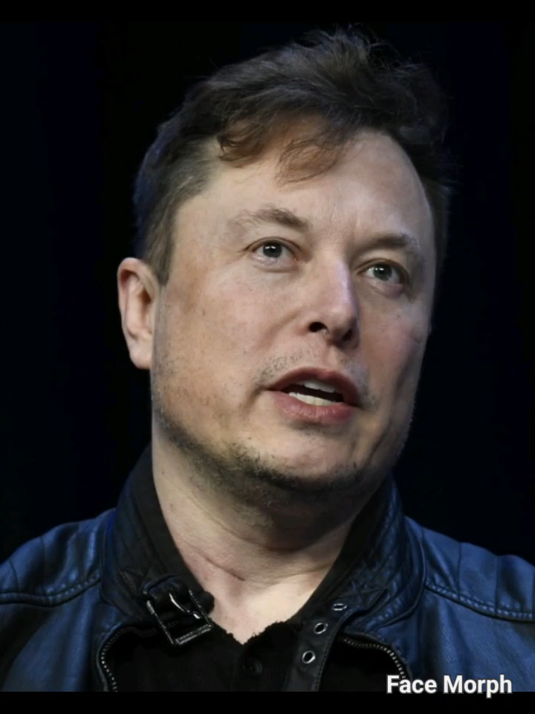
MORPHING
An effect in which a still or moving image is transformed into another.
Key points are set to the objects to ensure smooth transition.
27°C
Cloudy
10:17 AM
25/1/2023

Slide 16






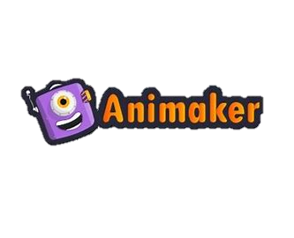


SOFTWARES & FILE FORMATS USED IN ANIMATION
2D Animation Softwares
2D File Format
swf
gif
Adobe Animate
OPENTOONZ
Html5 / javascript
Mov & mp4
animaker
27°C
Cloudy
10:17 AM
25/1/2023

Slide 17







SOFTWARES & FILE FORMATS USED IN ANIMATION
3D Animation Softwares
3D File Format
BLENDER 3D
MAYA
BLEND
3DS
obj
iffB
3DS MAX
27°C
Cloudy
10:17 AM
25/1/2023

Slide 18
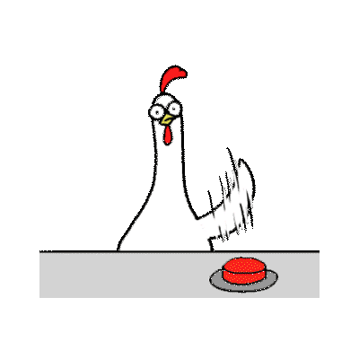
Thank You ☺
See You on next week!
27°C
Cloudy
10:17 AM
25/1/2023

